Slide 1
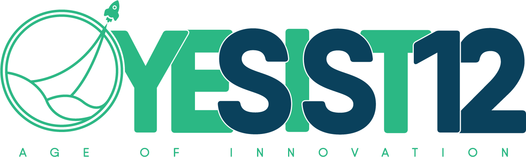
Team name:
TEAM Fuego
Team members details:
ROJIN RAJU
SRI SAKTICHARAN N
UMESH HARIHARA SUDAN M
IEEE YESIST12 – Makerfair 2020 – Project Submission

Slide 2
Fully automated hydroponic system for small scale production
Climate change and population increase are some major threats to the community. Climate change has caused a rise of 1 degree in earths temperature. Continued changes in the frequency and intensity of precipitation, heat waves, and other extreme events are likely, all which will impact agricultural production. Furthermore, compounded climate factors can decrease plant productivity, resulting in price increases for many important agricultural crops. Global food production patterns would be fundamentally altered by climate change, causing food insecurity, Increase in demand for food because of small shifts in seasonality and water availability.
“The Great threat to our planet is the belief that someone will save it.We have taken up this problem to be the someone that everyone is expecting.”
problem statement:

Slide 3
How important it is to solve this problem? What are the pains to be relieved and gains to be created?
Why it is so important to solve the problem ?
By 2050, the world population is to increase to almost 10 billion. By 2050 it is predicted that 64.1% and 85.9% of the developing and developed world respectively will be urbanized. Hence, farming lands well get scarce, this is why we need to envisage an alternative solution for farming, which is Vertical Farming with IoT to make it a efficient method to solve the problem of area availability and Demand for food in the upcoming years.
Pains to be relieved
Reduce Poverty of the people
To increase Food production.
To maintain the decent average per capita income(Agriculture backbone of the nation)
To reduce the demand caused due population exploitation.
Gains to be created
Controlled environment provided to grow off season crop anytime .
Increase the production faster with more yield.
To

Slide 4
Proposed Solution:
Indoor hydroponic vertical farm is the most logical way to overcome the issues of lack of land, water and resources.
In a hydroponic farm the crops are grown in the absence of soil with only the nutrient filled water given to the roots.
In order to make vertical farming a more feasible alternative we can provide a fully automated and easily portable solution with the help of IOT.
This way people who are enthusiastic to try out vertical farming can easily exercise it, making vertical farming a more commercially viable solution.
Our solution can be summed up in the following steps:
The customer is provided with a rack with multiple levels of arrays which contains all the provisions for constant irrigation, temperature and light control, nutrient level monitoring, etc.
The customer can choose any suitable crop and sow them in the arrays. The type of crop is updated to the system via an app.
The customer can fill the reservoir with a hydroponic solution as suggested by the app. Every parameter of the crop can be viewed by the customer via the app through various sensors.
The customer will get constant updates on when to refill the reservoir and harvesting period. When the crops are ready to harvest they can be sold and the process can be continued any time of the year

Slide 5
Working:
These seeds are kept in arrays of tubes and kept under intensive care till the first leaves starts to show.
The germinated seeds are the provided with constant flow of a hydroponic solution
The tubes are stacked vertically to use more space.
Unique Point:
Controlling the room conditions. with IoT.
Sterilizing and adding the required nutrients automatically according to the plants profile.
Atmospheric Temperature of the room is controlled using foggers , moisturizing valves and LEDs(used to provide proper wavelength of light).
The crops will be constantly monitored using sensors to sense their temperature, nutrition absorbed, growth rate, probable yield,etc.
These monitored values can be easily viewed via an app.
Since the process is fully automated no work needed during the growth process.
After the harvest , the crops are stored in a place with Atmosphere control to increase the shelf life.

Slide 6
Technological stack of your solution
Internet of Things:
Embedding sensors.
Microprocessor encoding.
Providing Internet connectivity via cloud.
CAD designing
App development
Android studios
Data science

Slide 7
Novelty of your project:
Our Project aims to develop this project in a very minimalistic way so that
Everyone can operate it easily .
Cost Efficient and easily available.
Easy to setup.
We provide Controlled environment for the Plants to grow Using IOT and Machine learning.
Target audience is not MNC’s or Multi million dollar companies but Micro small and medium Industries.
Sterilizing the Water(hydroponic sol) and using it again by adding required nutrients again automatically.
Moreover compared to Other similar product by MNC’s our Product is cheap and affordable.
Our product also provide atmosphere controlled Storage facility.
Can produce any types of crops year-round.

Slide 8
Application of your Proposed Solution:
The target beneficiaries for this project is anyone aspiring to make and sell off-season crops in the cityscape.
Our product can be used by hotels to obtain fresh crops.
Super markets and malls can also use this technology to provide fresh food much cheaper as transportation cost will not be an issue. They can grow plants in their premises.
This project aims to resolve the major problem that will faced by the community in future .(Taking the Increasing population in mind)
Round the year we can produce crops irrespective of the climatic conditions.

Slide 9
Dependencies of your solution:
The variety of food that can be grown is limited.
Capital expenditures, as well as the additional energy costs for lighting and heating, could outweigh any benefits.
Building complex plumbing and elevator systems to distribute food and water throughout is not easy.
All the Possible dependencies can be overcome In the Future Like:
Making the building run on Green energy will reduce the cost of energy
The varieties grow be Increased with Hybrid seed coming into action.

Slide 10
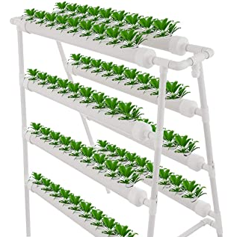
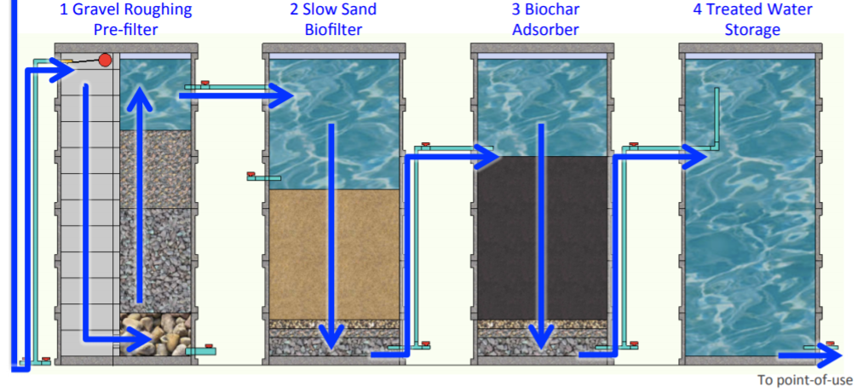
Components used:
Vertical pipe setup for planting the crops
Motor pup for circulating the hydroponic solution
IoT Sensor for Monitoring and controlling the solution.
Foggers and Moisturizing valve that will control the humidity and temperature.
Sterilizing tanks(It is done by Natural purification methods).
All the process are controlled via App or Website or Central hub.

